Slide 1



Role OF DATA ANALYTICS IN METAVERSE
AND HOW CAN BLOCKCHAIN CONTRIBUTE TO IT.
Presented by: TE CSE(DS)

Slide 2

INTRODUCTION
The metaverse, a virtual world combining physical and digital elements, offers a unique environment for interaction and innovation. Data analytics plays a pivotal role in harnessing the vast amounts of data generated within the metaverse to optimize user experiences and business operations. Blockchain technology, known for its secure and immutable nature, contributes significantly to data management and security within the metaverse.

Slide 3



DATA ANALYTICS IN THE METAVERSE
Importance of Data Analytics
Data analytics in the metaverse enables businesses to understand user behavior, trends, and performance metrics.
It provides insights into user engagement, activity, and preferences, allowing for data-driven decision-making
Types of Metaverse Analytics
Descriptive Analytics: Focuses on understanding current metaverse activities.
Predictive Analytics: Aims to forecast future trends and developments within the metaverse.

Slide 4
DATA ANALYTICS IN THE METAVERSE
Applications of Metaverse Analytics
Improving User Experience: Enhancing user interactions and personalizing experiences.
Optimizing Business Operations: Identifying popular products/services and resource allocation.
Developing New Products: Utilizing analytics to innovate and meet user needs effectively.
Benefits of Metaverse Analytics
Improved User Experience: Enhancing engagement and relevance for users.
Optimized Business Operations: Streamlining processes and decision-making.
Competitive Advantage: Leveraging insights for strategic positioning in the metaverse.

Slide 5
Blockchain Contribution to Metaverse Data Analytics
Secure Data Storage
Blockchain technology ensures data integrity and security through decentralized ledger systems.
It enables transparent and tamper-proof data storage, enhancing trust and privacy in the metaverse.
Immutable Data Records
All transactions and data entries are securely recorded on the blockchain, providing a reliable source of truth.
This feature ensures data authenticity and prevents unauthorized access or manipulation.

Slide 6
Blockchain Contribution to Metaverse Data Analytics
Smart Contracts
Smart contracts on blockchain networks facilitate automated data management processes.
They enable secure data sharing, enforce data access rights, and streamline data transactions within the metaverse.
In conclusion, data analytics in the metaverse, coupled with blockchain technology, revolutionizes data management, user experiences, and business operations in this dynamic digital realm. The synergy between data analytics and blockchain paves the way for innovative solutions and enhanced functionalities within the metaverse.

Slide 7


THANKS FOR LISTENING...

Slide 8








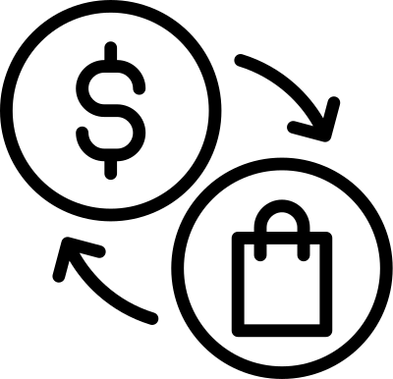




































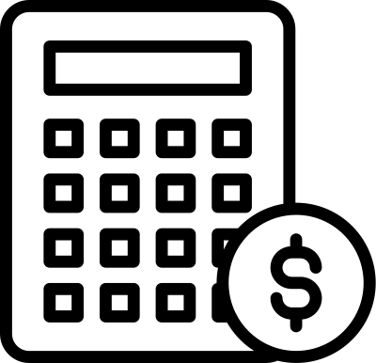


RESOURCE PAGE

